Slide 1


By: Nasrullah Hamad
LinkedIn
For. Dr. Batool Armouti
Business Intelligence.

Slide 2
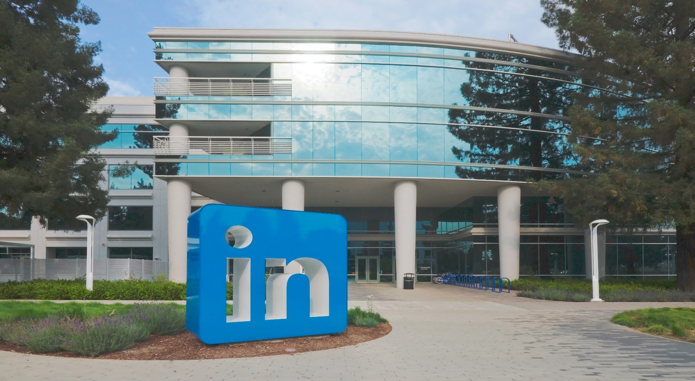
LinkedIn
About Me
About Company
About Service
I'm a Junior Data Analyst at LinkedIn. I help improve decision-making by creating business intelligence solutions. I love turning data into meaningful information that helps companies grow and engage with their audience effectively.
LinkedIn connects professionals and companies around the world, allowing them to showcase their work, recruit talent, and share content
My job is to analyze data from company pages, job postings, sponsored content, and more, to provide insights that help businesses succeed on our platform

Slide 3

LinkedIn
Business Intelligence: Refers to a system that combines tools and processes in order to achieve a goal that provides businesses with complete actionable data that aids them with their decision making.
Business Intelligence uses many tools and techniques to create a business intelligence application. Such as.
- Dashboards and scoreboards. Dashboards are used in Tactical decision making, scoreboards are used in Strategic decision making.
- Data Visualizations. Plots and visualizations vary in sizes, the type of data presented, the features included, and the task of the BI application.
- Systems that support the BI application, such as Microsoft Power BI and Tableau.
- Data Preprocessing, which can be made by handling missing values inside the benchmarking dataset and many processing techniques. That help get accurate and helpful visualizations for better decision making.

Slide 4
LinkedIn
For the LinkedIn Business Intelligence application. I used Microsoft PowerBI to create a dashboard that allows the company to follow two approaches.
1- Marketing approach. While focusing on how LinkedIn is used as a job hiring tool globally, with interactive visualizations. This can allow the CEOs of the company to study different ways and approaches to identify trends and focus on the marketing side of the company. While giving attention to arising problems.
2- Maintenance approach. Which allows the company to improve the job listing hirings, given the amount of (Null) values found inside the dataset. This approach allows the maintenance team of the website to understand the need for improvement and changing of some parameters when hiring people, which can support the requirements needed to hire employees for different companies and increase the satisfaction when it comes to hiring new employees by LinkedIn

Slide 5
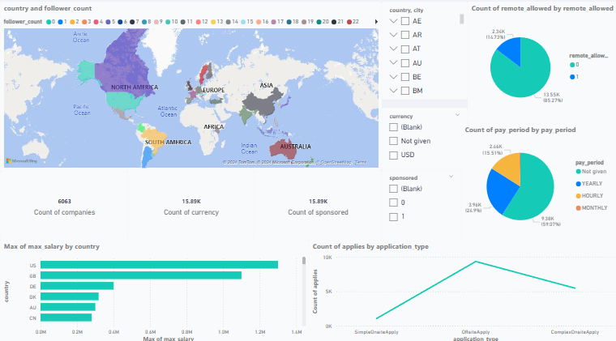
LinkedIn
This is a picture of the Dashboard I created using PowerBI which combines the two approaches mentioned earlier. Noting that each plot is interactive and can present a good example of trends and problems encountered all over the world.

Slide 6

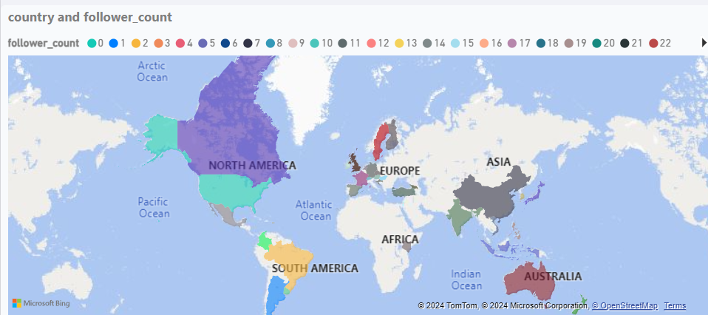
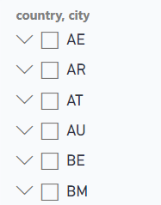
LinkedIn
The Marketing Approach:
The first visualization plot for the marketing approach is a Map Plot. It considers the count of followers for LinkedIn based on which country they are from. By using the slicer on the right, or the map plot itself, users can interact and choose which country they want to study and conduct decision making on. This plot will be beneficial to know which country to focus on when making advertisements and campaigns to gather more audience and subscribers. While enhancing the poor countries with low following count.

Slide 7
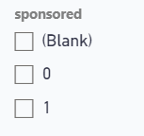
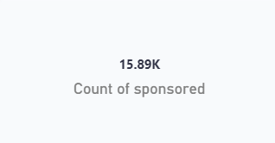
LinkedIn
The second plot studies the number of sponsored job hirings. Looking at this number, we can decide on the list of countries by using the previous plots, to check the countries that have a higher sponsored rate and help sponsor some of the jobs. This can help raise the reputation of the website and increase the competitive level of LinkedIn. The slicer on the right can also help users interact and identify which of the companies are sponsored and which aren’t.

Slide 8
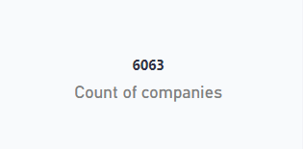
LinkedIn
The third plot that can help in the marketing approach, is a card plot that studies the count of companies in all countries inside the given benchmarking dataset. By Interacting with the previous plots. We can identify how many companies are in each country and city. And whether the companies are sponsored or not. Which can help manage the sponsoring decision making approach if taken.

Slide 9
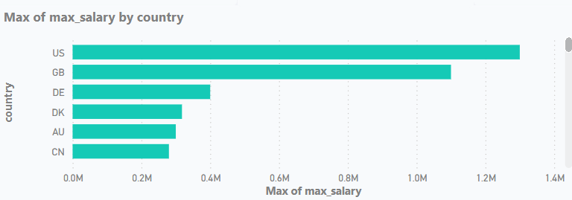
LinkedIn
The fourth plot is a horizontal bar plot that identifies the counties that have the maximum salaries. They were purposefully ordered from maximum to minimum to help identify which country can pay the most for its employees, and focusing on that country in advertisements, since it pays in large amounts. Another approach can be followed here, is to work with other plots and interact with them, to be able to study a country of interest.

Slide 10
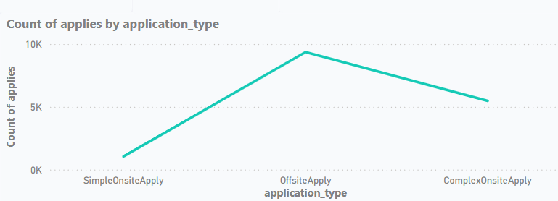
LinkedIn
The last plot in the marketing approach, is a Line plot that identifies the relationship between the application type and the count of applies to each type. By studying this plot, we can find that most applying candidates choose the offsite apply, which is an online application form made between the company and the employee. Since most employees prefer this way. We can encourage and develop a LinkedIn based system that involves an offsite application system, between the company and the employee. This way, we can gather many people and organizations to use the LinkedIn system. Though, it may have some downsides, such as the cost and the regular maintenance for such system.

Slide 11
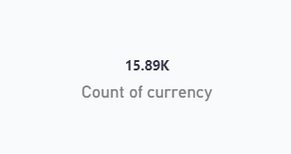
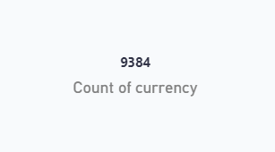
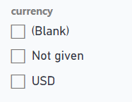
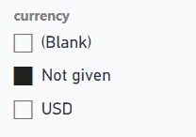
LinkedIn
The Maintenance approach:
The first visualization in the maintenance approach, is a card plot that identifies the number of job listings that ignored the currency option in the listing. Which is a very necessary parameter to consider. Since the employees who’re looking for jobs, will definitely look for which currency they are going to be paid with. The amount of Null values found inside this feature is 9,384 which is more than half of the data. Allowing this feature to be a necessity when creating job applications is strongly advised. Since it will validate the job application and increase the trust of the employee

Slide 12
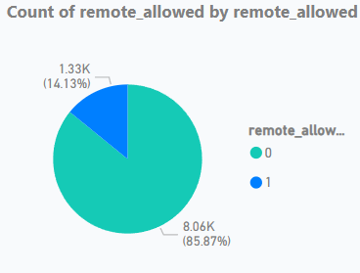
LinkedIn
The second plot inside the maintenance approach, is a pie chart that studies the number of remote allowed hirings inside the companies. This means whether the employees will be allowed to work onsite or offsite (remotely). The 0s in this pie-chart represent the Null values inside the feature. Which is not acceptable. Since most employees will be looking to know whether their work will be remotely or no, before they apply for a job. This option is strongly advised to be changed to mandatory so employees know if their work is remotely or not, and to encourage them to apply to new jobs.

Slide 13
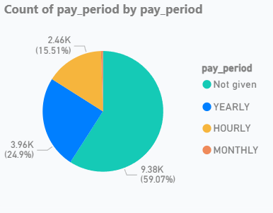
LinkedIn
The third plot is another pie-chart that studies the relationship between the pay-periods. Given the plot, it can be shown that the Null values took more than half of the plot, which lets the employees that want to apply for jobs, not noticed of the pay-period whether it will be yearly, monthly, or hourly. This changes from the type of the job that’s going to be applied by the employee. And the employee needs to know what the pay-period is, since nowadays, the highest priority for employees when it comes to jobs is the payment period. To have a better reputation and to attract new hirings. This option should be made mandatory for the companies to specify the pay-period. This chart can be interacted with to study the different pay-periods.

Slide 14
LinkedIn
This concludes the plots for both approaches that have been studied in PowerBI’s dashboard. Each plot is interactive with the other plots, and will ensure the users of it, a user-friendly experience filled with many actionable decisions to be made for both approaches.
There have been many companies that used Dashboards and visualizations in their decision-making over the years. To enhance their user experience and make strategic decisions that would impact the platform on a long-term basis. Some of these companies are:
X (Formerly Twitter)
Starbucks
Walmart
Uber
Notes:
https://www.toucantoco.com/en/blog/business-intelligence-examples
https://builtin.com/articles/business-intelligence-examples-applications

Slide 15

X (Twitter)
Twitter has used business intelligence in its way to success, by studying the data generated from the daily log-ins and tweets with their interactions. Twitter has been one of the most successful companies in the social media industry. By applying knowledge from many tools like Google Analytics and Tableau. It made some very high-praising decision making over the years.
In 2017, a very controversial announcement was made by the company to doubling the character limit on the posts. From 140 characters to 240 characters. The users of the platform joked about the decision and made sure to use the feature when it will be implemented. But it wasn’t.
The reason behind it not being implemented is that they conducted a development test to see whether users with the 280 character limit will actually use them. It turns out they didn’t and most of their posts were under the 140 character limit. Which made this change a bit useless and a waste of memory for the application.
The way this change was studied was with the use of business intelligence tools. They noticed that the tweets made by the users were in the same word limit as if the change wasn’t made. This kept the website being easy to use.

Slide 16

Starbucks
Starbucks is one of the most popular coffee places to order from. Many people prefer Starbucks coffee over the other stores, because of many preferences. One being the location. But how do Starbucks choose the location of their coffee store?
Starbucks use many business intelligence tools to identify the perfect store location to be implemented on. Based on many points being, the population density, the traffic patterns, the businesses that locate the area, and the consumer demographics. And many more points. Starbucks puts these factors under consideration using a business intelligence tool such as Atlas, and then chooses the perfect location for a store.
Another use of BI by Starbucks was when they introduced a new Frappuccino drink as a promotion, and based on the BI analysis of the drink. It became a favorite for many individuals and the company kept making it as a daily drink.
Starbucks also introduced a system called My Starbucks rewards, which is a loyalty program for the consumers of the coffee, it gained the attention of many individuals, and increased the sales of the company. Which allowed Starbucks to use analytical programs to identify what the customers exactly want and providing it to them.

Slide 17
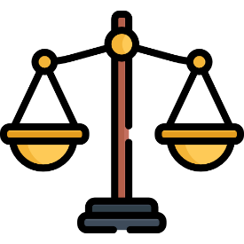
Legal Issues
There are many legal issues when it comes to working with Business Intelligence tools, They should be examined and avoided, so the company doesn’t go against the law. These issues can involve compliance with industry-specific regulations, Data privacy, security, and ownership, and compliance with general and anti-discrimination laws.
1- Compliance with industry regulations: Different industries have different and specific regulations that should be attached to when using different Business Intelligence tools, such as the healthcare industry. Which involves using insurance and accountability to any health-related problems when using the tools.
2- Data Privacy, security, and ownership: We need to verify the data that we’re using in the BI tools before working with it, to protect sensitive organizational information from theft, corruption and many other attacks. By encrypting the data using a key, data resiliency, or using two-factor authentication to protect the clients and the data. To lower the legal risk and ensure that the data is private and completely secure, and to ensure the trust of our clients. The data sources should also align with the legal standards in terms of privacy regulations and property rights, which will ensure the data ownership and avoid any legal issues
3- Compliance with general laws: We should ensure that the BI tools used comply with contracts such as data sharing agreements, and with how stakeholders use, collect, and process the data that’s used by the BI tools. We should also monitor the compliances daily to avoid any legal issues.

Slide 18
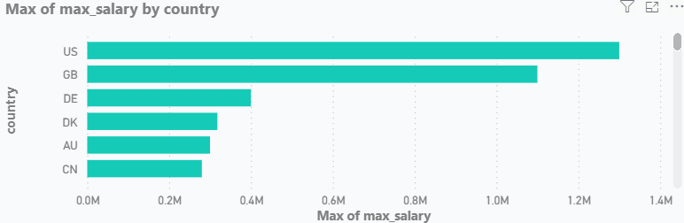
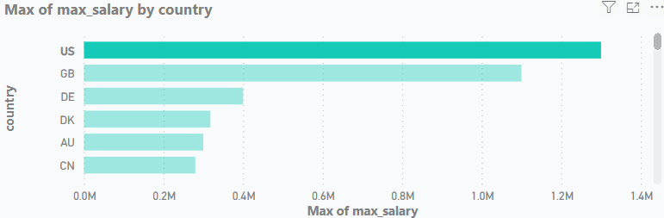
LinkedIn
As a conclusion to this presentation, Business Intelligence tools are made to help organizations achieve their goals in a quick and effective manner, while applying accurate and efficient decision making. The company can grow competitively and environmentally. Many employees will gain the trust of the organization and while following regulations swiftly and accurately. They can avoid any legal issues when conducting decisions on the short and long term.
While having an interactive and functional BI tool such as Dashboards. The company can have efficient time-consuming decision making since they can find what they are looking for quickly and easily.
Based on the previous examples of how companies used business intelligence tools to improve their audience number. It can be said that such tools can make a difference in the amount of customers gained in periods of time. Whether the decision-making was done tactically or strategically. Companies like Starbucks, Walmart, Reddit and many more, have achieved a bigger audience picture by applying Business intelligence tools in their daily operations.
BI tools enhance the processing of the data, and reduce decision times. They also reduce the costs of such decisions, since they can prevent and avoid bad and costing decisions. Doing so, will increase the stakeholders’ trust and satisfaction. And will involve many improvements in the company’s competitive levels. By doing effective and timely decisions.

Slide 19
Thanks.
LinkedIn

